Slide 1
“Keeping Your Balls In The Air” ACT World Conference 2013

Slide 2
Be Present
Contact with the
Present Moment
Acceptance
Values
Psychological
Flexibility
Do What Matters
Open Up
Defusion
Committed Action
Self-as-context
2

Slide 3
Disengaged; disconnected; distracted; deficits in perspective taking
Be Present
Psychological
Flexibility
Psychological
Rigidity
Experiential avoidance & fusion
Action ineffective
&/or inconsistent
with values
Do What Matters
Open Up
3

Slide 4
Be Present
Psychological
Flexibility
Do What Matters
Open Up
4

Slide 5
Exercise: ten-minute history
Please complete this sentence: “I’ll know therapy is working when ….”
If magic could happen and anything were possible, how would you be living your life differently? What would you start or stop; do more of or less of?
If our work could improve one relationship in your life, which one would it be, and how would it improve?
What is stopping these things from happening?

Slide 6
While taking history, note:
Avoidance – verbal & non-verbal
Fusion – especially ‘rule-speak’
Disconnection (internal &/or external), disengagement, distractedness
Disconnection with values & goals
Acceptance
Defusion
Presence, task-focussed attention, self-awareness
Clarity/connection with values & goals

Slide 7
Exercise: complete a triflex assessment
During your ten minute interview, what processes did you see?
Brainstorm where you might go in terms of intervention

Slide 8
Be Present
Psychological
Flexibility
Do What Matters
Open Up
8

Slide 9
HEAR
SEE
TOUCH
FEELINGS
TASTE
THOUGHTS
SMELL
PAIN
MEMORY
FEELING
SENSATION
THOUGHT
URGE

Slide 10
HEAR
SEE
TOUCH
FEELINGS
TASTE
THOUGHTS
SMELL
ACCEPTANCE &
SELF-COMPASSION
PAIN
VALUES & ACTION

Slide 11
Drop Anchor

Slide 12
So a painful thought/feeling/memory has just shown up, and I want to help you to handle it
Push your feet hard into the floor
Sit forward in your chair
Push your hands hard together
As well as this painful thought/feeling/memory, notice your body in the chair – hands, feet, back etc.
Also look around – notice 5 things you can see
Also notice 3 or 4 things you can hear
Also notice you and I, working together
So notice there is a painful thought/feeling/memory here – AND your body in the chair - AND a room around you - AND you and I working together on something you care about
AND also notice you are fully in control of your actions right now; check it out – move your arms and legs

Slide 13
Gentler ways to get clients present?
What are you noticing now?
What’s showing up for you?
What are you aware of?
And what else? And what else? And what else?
Can I get you to notice ….
Can you notice what your mind is saying?

Slide 14
Gentler ways to get clients present?
What are you noticing in your body?
Let’s come back to what we’re doing here, right now; to what this work is about
I’ve lost you; you’re back
You seem distant/disengaged/distracted
I feel disconnected from you

Slide 15
Gentler ways to get clients present?
Let’s come back to what we’re doing here, right now; to what this work is about
Can we take a moment just to notice what is happening here, between you and me?
I’m noticing X, Y, Z … and I wonder if you are, too?

Slide 16
Gentler ways to get clients present?
Do you notice how:
Your mind keeps hooking you
Your attention keeps wondering
Whenever I ABC, you tend to DEF

Slide 17
Gentler ways to get clients present?
Can we just pause for a moment, and
- Take stock
Notice what’s going on
Let the dust settle
Take a moment to center ourselves

Slide 18
Be Present
Contact with the
Present Moment
Acceptance
Values
Psychological
Flexibility
Do What Matters
Open Up
Defusion
Committed Action
Self-as-context
18
Notes:
Robyn’s exercise to day 1 – bull’s eye to day 2

Slide 19
Self-as-context: ‘new’ definition
W T F ??!!!
Hayes, 2011:
“Self-as-context is the coming together and flexible social extension of a cluster of deictic relations (especially I/here/now) that enable observation and description from a perspective or point of view.
Self-as-context enables or facilitates many different experiences, including theory of mind, compassion, self-compassion, empathy, acceptance, defusion, and a transcendent sense of self.”

Slide 20
Self-as-context: ‘new’ definition
“Flexible Perspective Taking”
Ability to observe and describe from a perspective or point of view
enables or facilitates many different experiences,
including theory of mind, empathy, compassion, self-compassion, acceptance, defusion ….
and a transcendent sense of self (often called ‘the observing self’).

Slide 21
A Bit of RFT

Slide 22
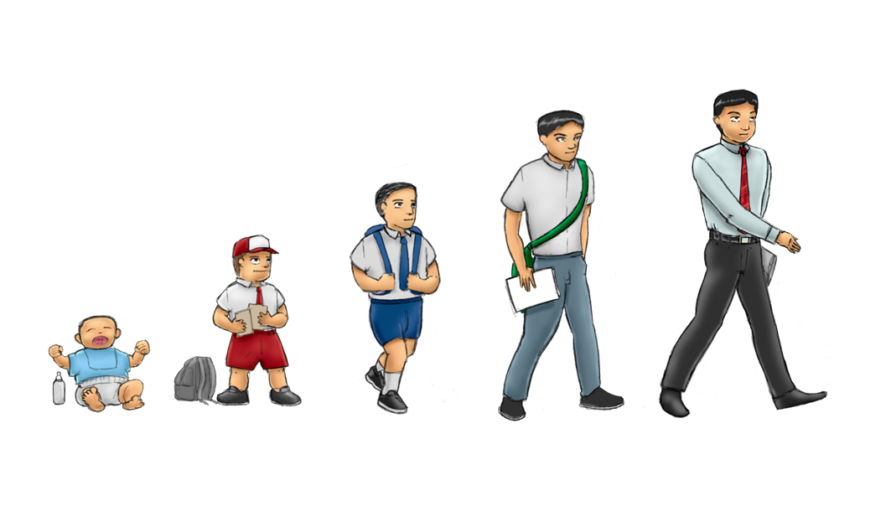
“I”
“You”
“Here”
“There”
“Now”
“Then”
DEICTIC FRAMING

Slide 23
“What are you doing here?”
“What am I doing here?”
“ What were you doing there?”
“What was he doing there?”
“What are you doing now?”
“What are they doing now?”
“What was she doing then?”
“What were you doing then?”
The only constants?
I
Here
Now
Notes:
The child learns to relate her own behavior as different from that of others by learning three key relations which are “I versus YOU (& HE/SHE/IT/THEY)”, “HERE versus THERE” and “NOW versus THEN”.
She learns to respond appropriately to questions such as ‘What are YOU doing HERE?’, ‘What am I doing NOW?’, ‘What was I doing THEN?’ etc.
She will gradually learn to respond appropriately to these questions and as she does so she will see that whenever she is asked about her own behavior she always answers from the point of view of ‘I’, ‘HERE’ and ‘NOW’ and that this perspective is consistent and different from that of other people.
For example, if you ask me about my behavior, I will always answer from the position of ‘I’, ‘HERE’ and ‘NOW’ in response to your question asked by YOU, THERE (where you are) and THEN (when you asked – a few seconds ago).
I is always from this perspective here, not from someone else's perspective there
A sense of perspective is therefore abstracted through learning to talk about one's own perspective in relation to other perspectives

Slide 24
Perspective Taking Skills
YOU
HERE
NOW
I
THERE
THEN
Slide Courtesy of Steve Hayes

Slide 25
Self-as-Context
‘Flexible Perspective Taking’
The ‘locus’ of consciousness: everything is noticed from a perspective of ‘I, here, now’
Slide Courtesy of Steve Hayes

Slide 26
CONTACTING THE PRESENT MOMENT
I, here, now notice WHAT I see, hear, touch, taste, smell, think, feel, do
SELF-AS-PROCESS
I, here, now notice THAT I see, hear, touch, taste, smell, think, feel, do
DEFUSION
I, here, now notice my thoughts and see them as words and pictures
COMPASSION
I, here, now notice suffering and respond
with kindness
Self-as-Context
ACCEPTANCE
I, here, now notice my thoughts and feelings and allow them to be as they are
EMPATHY
I, here, now notice what someone else is feeling and feel it too
TRANSCENDENT SELF
or OBSERVING SELF
I, here, now notice THAT I am continuous, unchanging, distinct from, & more than WHAT I see, hear, touch, taste, smell, think, feel, do
COMMITTED ACTION
I, here, now notice my actions and take control of them
VALUES
I, here, now notice what is important and meaningful to me and put it into words

Slide 27
TEA
WATER ……… plus tea leaves
MILK
WATER………. plus various fats, proteins & sugars
Water
ORANGE JUICE
WATER …….. plus
bits of orange
BEER
WATER ……. plus beery stuff
COFFEE
WATER…….. plus coffee bean extracts

Slide 28
Self-as-context
All current ACT Books (except one) have the ‘old’ definition:
Self-as-context is the observing or transcendent self; i.e. they are synonymous
But is water synonymous with tea?
To make tea, we add stuff to water
To ‘make’ an experience of the observing or transcendent self, we add stuff to S-A-C

Slide 29
Self-as-context …. plus what?
To experience observing/transcendent self:
Deictic framing (S-A-C)
I, here, now notice
Plus
THAT ‘I’ am (or ‘a part of me’ is)
Frame of distinction
distinct from
Plus
WHAT I see, hear, touch, taste,
smell, think, feel, do
Hierarchical frame
and there is more to ‘me’ than
these thoughts, feelings, sensations
actions and body parts
Plus
Temporal frame
and ‘I’ am continuous & unchanging
whereas thoughts, feelings, sensations,
actions and body parts constantly change

Slide 30
“Notice X”
Contact with the Present Moment = notice WHAT you see, hear, touch, taste, smell, think, feel, do
Self-as-process = notice THAT you are seeing, hearing, touching, tasting, smelling, thinking, feeling, doing …
… and noticing
Observing/transcendent self = notice THAT you are noticing…
… and that the you (or ‘part of you’) which notices is continuous, unchanging, distinct from, more than WHAT you see, hear, touch, taste, smell, think, feel, and do
Self-as-context = flexibly noticing from a perspective of I, here, now (i.e. flexible perspective taking)

Slide 31
The ‘Observing Self’: why bother?
Aids defusion – especially from the conceptualised self
Aids acceptance, willingness, and formal exposure: a ‘safe place’ inside you
Important aspect of spirituality
For survivors: a part of you was unharmed
Sense of stability in a chaotic life
NB: 1 & 2 are easily achieved through defusion & acceptance skills without need for explicit ‘observing self’ exercises.

Slide 32
Self-as-context = flexible perspective taking
Able to take perspective on ‘self’ (i.e. ongoing stream of thoughts, feelings, actions)?
‘Self-as-process’
Able to take perspective on thoughts & feelings?
‘Foundation’ for defusion & acceptance
Able to take perspective on self-story?
Foundation’ for defusion from the conceptualized self
Able to take perspective on one’s own noticing?
‘Foundation’ for transcendent or observing self
Able to take perspective on another?
‘Foundation’ for Theory of Mind, Empathy, Compassion

Slide 33
Exercise: Come back to center #1
a) ‘Do what matters’
When the bell sounds:
b) ‘Be present’
Do this any time,
often as desired
Be Present
Psychological
Flexibility
Do What Matters
Open Up
33
33

Slide 34
Do what matters <=> Be present
Explore values & goals with the client
When fusion &/or avoidance shows up => be present
If no barriers, when bell rings => be present
E.g. ask client to:
notice what’s happening
what’s showing up for you?
what is your mind doing?
what do you feel in your body?,
- use ‘noticing’ language

Slide 35
Exercise: Come back to center #2
a) ‘Open up’
When the bell sounds:
b) ‘Be present’
Do this any time,
often as desired
Be Present
Psychological
Flexibility
Do What Matters
Open Up
35
35

Slide 36
Open up<=> Be present
Ask ‘What’s stopping you from X,Y,Z?’
If strong fusion/avoidance => be present: ‘drop anchor’
Use being present as a launching point for opening up:
Notice what your mind is doing => defusion
Notice what is happening in your body => acceptance
Notice there go your thoughts and feelings, and there’s a part of you that can ‘step back’ and notice them => defusion, acceptance

Slide 37
Workable In-Session Behaviour
What might we look for?
How might we reinforce it?

Slide 38
Reinforcing Workable Behaviour
5 overlapping strategies:
1. Do you notice …..?
2. What is that like for you?
3. How might this be helpful?
4. What I notice ……
5. What that is like for me …..

Slide 39
Unworkable In-Session Behaviour
What might we look for?
How might we address it?

Slide 40
Addressing Unworkable Behaviour
5 overlapping strategies:
1. Do you notice …..?
2. What is that like for you?
3. How might this be unhelpful?
4. What I notice ……
5. What that is like for me …..
Why don’t we address it?

Slide 41
A – Antecedents | B – Behaviour | C- Consequences (reinforcing)
‘TRIGGERS’
‘PAYOFFS’
Situation
Thoughts
Feelings
Something an
organism does
immediate outcomes
that maintain the
behaviour
- Public
- Private
Present Moment,
Defusion,
Acceptance
Values &
Committed action
Feeling of relief; anxiety disappears
Situation: the client is doing some form of problematic behaviour
Thoughts & Feelings
Anxiety
‘If I confront this, that’s rude/ will destroy rapport/ she’ll get angry or upset/ he’ll leave/ she’ll complain about me’ ‘She needs to do this!’
Therapist/coach makes no active attempt to point out, confront, address or interrupt the client’s behaviour. Instead, opts for ‘active listening’
Workability
payoffs VS costs
Costs:
Client’s problematic behaviour persists
Unable to do effective therapy/coaching
Increasing frustration, anxiety/ boredom/ disengagement for the therapist/coach
WHAT’S MORE WORKABLE?
Notes:
Not just values questions – all sorts of questions
Demo ways of doing it

Slide 42
Contact With The Present Moment
I’m noticing something problematic here and I’d like to share it with you
Acceptance
Values
I’m feeling pretty
anxious about it.
My heart’s racing.
But my aim in here is to help people live better lives – so if I ignore this, I’m not being true to myself and I’m doing you a disservice
Psychological
Flexibility
Defusion
Committed Action
My mind’s telling me
you’ll be upset or angry
or think I’m rude, or this
will damage our
relationship
So even though I’m feeling really nervous, I’m going to tell you what
I’ve noticed
Self-as-context

Slide 43
Exercise: Open up<=> Do What Matters
a) ‘Do what matters’
When the bell sounds:
b) ‘Open up’
Do this any time,
often as desired
Be Present
Psychological
Flexibility
Do What Matters
Open Up
43
43

Slide 44
Exercise: Open up<=> Do What Matters
Explore values & goals with the client
When fusion &/or avoidance shows up => open up
If necessary, ask ‘So what’s stopping you?’
After some defusion/acceptance => do what matters
Feel free to go (either way) via ‘be present’
If you have time, and it seems relevant, see if you can ‘make the link’: willingness to make room for these thoughts and feelings in order to do what matters

Slide 45
Exercise: Reinforcing Workable & Addressing Unworkable Behaviour
1. Do you notice …..?
2. What is that like for you?
3. How might this be helpful/unhelpful?
4. What I notice ……
5. What that is like for me …..

Slide 46
A Common Reply To Questions About Values:
Consider the
function of
this behaviour
Is it a request for help, due to lack of knowledge?
If so, do brief psychoeducation, give some examples of values, then do an experiential exercise
A far more common function of ‘I don’t know’:
I DON’T KNOW!

Slide 47
Validate: yes, right now, you don’t know.
So would you be willing to:
Sit with the question a bit longer?
Do an exercise?
Fill in a worksheet?
Do a card sort?
A – Antecedents | B – Behaviour | C- Consequences (reinforcing)
‘TRIGGERS’
‘PAYOFFS’
Situation
Thoughts
Feelings
Something an
organism does
immediate outcomes
that maintain the
behaviour
- Public
- Private
Present Moment,
Defusion,
Acceptance
Values &
Committed action
Do an exercise with me?
Conversation ends
Feeling of relief; anxiety/confusion disappears
Situation: therapy/coaching session – being asked about values
Thoughts & Feelings Oh shit!’ ‘I don’t know!’
Anxiety, confusion. Urge to change the topic
Says ‘I don’t know’
Workability
payoffs VS costs
Costs:
Fail to clarify values,
Fail to set meaningful
Goals
Remain stuck – nothing changes
DIFFERENTIAL REINFORCEMENT
OF A MORE WORKABLE BEHAVIOUR
Notes:
Not just values questions – this is true for all sorts of questions
Demo ways of doing it

Slide 48
Get People Moving: 3 Factors
Small change
Positive direction
Owned by the client
On a scale of zero to ten, how likely are you to do this?

